Slide 1
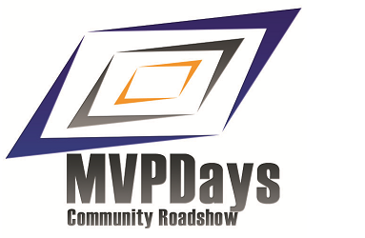
Going from PowerShell Newbie To PowerShell Ninja
Who needs a subtitle?
#MVPHour
#CDNMVPDays
@MrThomasRayner

Slide 2

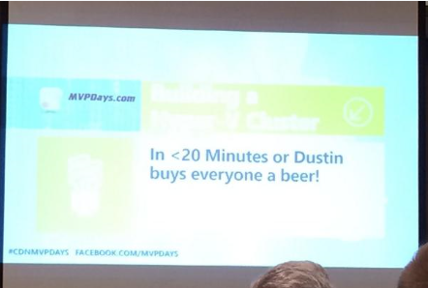


Don’t forget to tweet #CDNMVPDays and Win

Slide 3

Who’s this guy?
Thomas Rayner, MVP
Systems Admin
NAIT Instructor
Edmonton Microsoft User Group – emug.ca – Sign up for our mailing list
Blog: workingsysadmin.com – links and slides will be uploaded tomorrow
Twitter: @MrThomasRayner
LinkedIn: linkedin.com/in/thomasrayner
Email: ThmsRynr@outlook.com
… and I’m a PowerShell MVP (but not a PowerPoint MVP)

Slide 4
Who are you people? Why do you want to be a PowerShell Ninja?
You’re a PowerShell user whether you admit it or not
Have you installed a Microsoft product lately?
Do you have mundane, repetitive tasks you’d rather automate?
PowerShell is the way of the future
Remote administration
Bulk administration
Faster, smarter, more fool proof administration
Plus Microsoft seems to really like it

Slide 5
Oops

Slide 6
So what’s the path look like?
PowerShell Newbie |  | Enthusiasm |  | PowerShell Ninja
 | Dabbling |  | Prolific scripter
@MrThomasRayner

Slide 7
From PowerShell Newbie to Dabbling
Many of you who are “not scripters” are somewhere along this path
What you do
Copy and paste code from other sources (without much understanding of the code)
Your resources
Google Bing search results
A coworker who made you use PowerShell

Slide 8
From Dabbling to Enthusiasm
There’s a distinct change in attitude for a lot of people in this phase
What you do
Seek out opportunities to use PowerShell
Start writing a little of your own code
Your resources
Still probably a lot of Bing search results and coworkers
TechNet

Slide 9
From Enthusiasm to Prolific Scripter
You’re starting to participate in the PowerShell community in this phase
What you do
Learning scripting theory
Identifying more places where scripting meets your needs
Writing more complex scripts
Starting to specialize
Participating in the PowerShell community

Slide 10
From Enthusiasm to Prolific Scripter (continued)
Your resources
Part of the fun here is finding out which resources work best for you
Blogs, blogs, blogs
Hey, Scripting Guy!
PowerShell.org
Working Sysadmin (shameless plug)
So many more
Twitter
twitter.com/MrThomasRayner/lists/powershell-people
User Groups
powershellgroup.org
Edmonton Microsoft User Group – EMUG.ca

Slide 11
From Prolific Scripter to PowerShell Ninja
There’s another distinct change in attitude for most people in this phase, too
What you do
Write advanced scripts
Help sections, scalable, reusable, modular
Share your scripts
Go from participating in the PowerShell community to contributing and providing a little leadership

Slide 12
From Prolific Scripter to PowerShell Ninja (continued)
Your resources
You ARE the resource

Slide 13
What does growth look like now?
Where are you at?
Technical expert
Community leader, contributor
Specialized in at least a couple areas
Where do you go?
Expand your circle of influence
Increase your areas of specialization

Slide 14
Questions?
Connect with me
Twitter: @MrThomasRayner
Blog: workingsysadmin.com
EMUG: emug.ca
Email: ThmsRynr@outlook.com
LinkedIn: linkedin.com/in/thomasrayner
Don’t forget to tweet during this event using #CDNMVPDays

